Slide 1
Customer Segmentation Analysis
Prepared by: Dinesha K Y
Course: Certified data analyst
Batch id: 11-aug-25-cda-bun-040-wdm1130-ban
Tools Used: Power BI, MySQL
Mentor: Datamites

Slide 2
Introduction
Customer segmentation is the process of dividing customers into distinct groups based on their purchasing behavior and characteristics.
Effective segmentation helps businesses understand customer needs, optimize marketing strategies, and improve revenue performance.
This project applies customer segmentation techniques on U.S. retail transaction data to analyze spending patterns across age groups, product categories, payment methods, seasons, and locations.
The insights are presented using Power BI to support targeted marketing and data-driven business decisions.

Slide 3
Project Objectives
To analyze customer purchasing behavior using retail transaction data.
To identify key customer segments based on age, spending, and purchase patterns.
To evaluate sales performance across product categories, payment methods, and seasons.
To identify product categories where discounts are most effective.
To provide data-driven insights for targeted marketing and business decision-making.

Slide 4
Dataset Overview
The dataset consists of 3,900 customer transaction records from the U.S. retail market.
It includes customer demographics such as age and gender, along with purchase details like product category, purchase amount, payment method, discounts, season, and location.
Each record represents a single customer transaction, enabling detailed analysis of shopping behavior.
The dataset supports customer segmentation and identification of key sales and spending patterns.

Slide 5
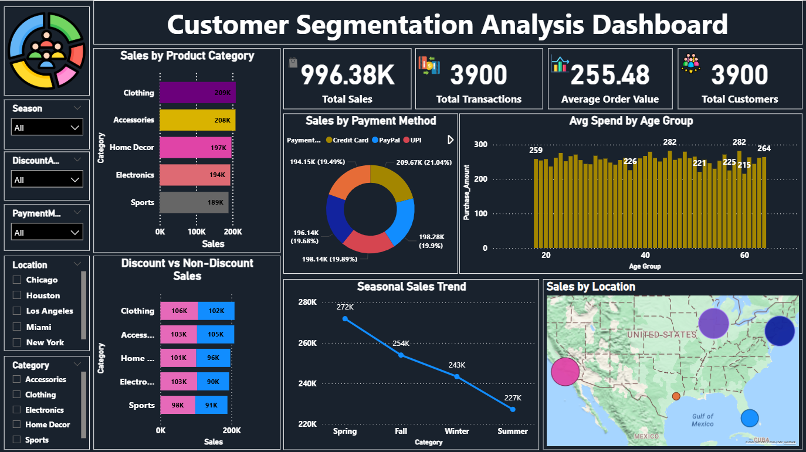
Dashboard Overview

Slide 6
KPI Summary
Dashboard displays 4 major KPIs:
996.38
3900
255.48
3900
Total Sales
Total Transactions
Average Order Value
Total Customers

Slide 7
Combined Insights (Summary)
A small number of product categories contribute the majority of total sales and revenue.
Middle-aged customer groups show higher average spending and transaction contribution compared to other age segments.
Card-based payments are the most preferred payment method among customers.
Discounted sales contribute less revenue than non-discounted sales, indicating selective discounting is more effective.
Sales performance varies by season and location, highlighting opportunities for seasonal and regional targeting.
Clear customer segments can be identified based on spending behavior, age, and purchase patterns.

Slide 8
Conclusion
This customer segmentation analysis successfully identified key patterns in customer purchasing behavior across product categories, age groups, payment methods, seasons, and locations. The results show that middle-aged customers and specific product categories contribute the highest share of total sales and revenue, while card-based payments remain the most preferred transaction method. Discounted sales contribute less revenue compared to non-discounted sales, indicating the need for selective discount strategies. Seasonal and geographic trends further influence overall sales performance. Overall, the insights derived from this project support targeted marketing, optimized pricing strategies, and data-driven business decision-making.

